Slide 1

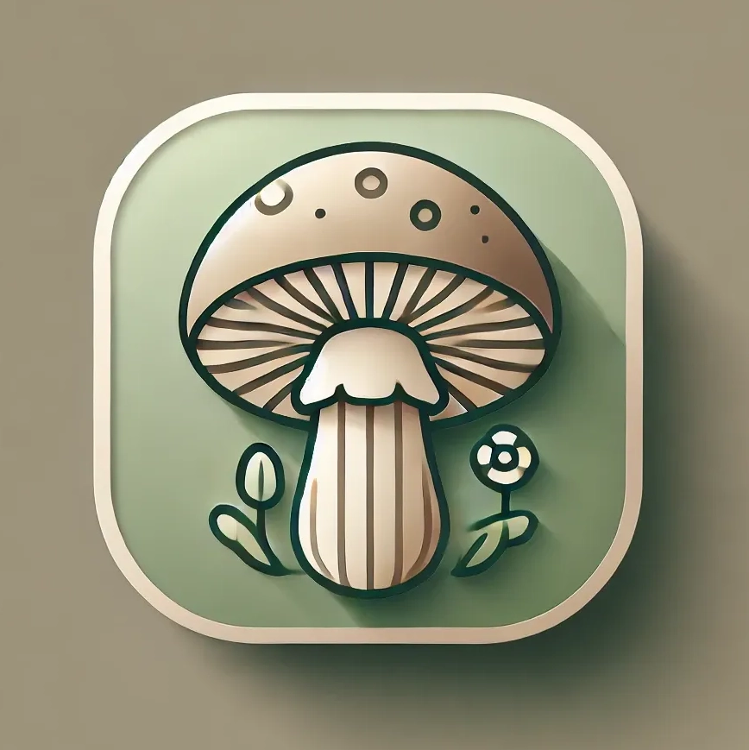
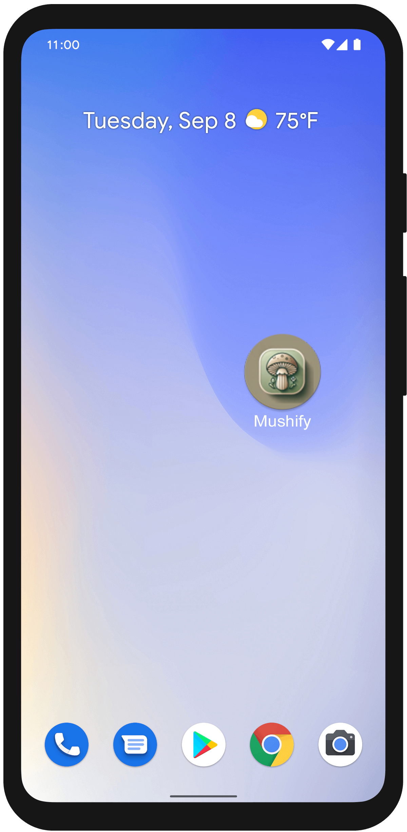
MUSHIY

Slide 2


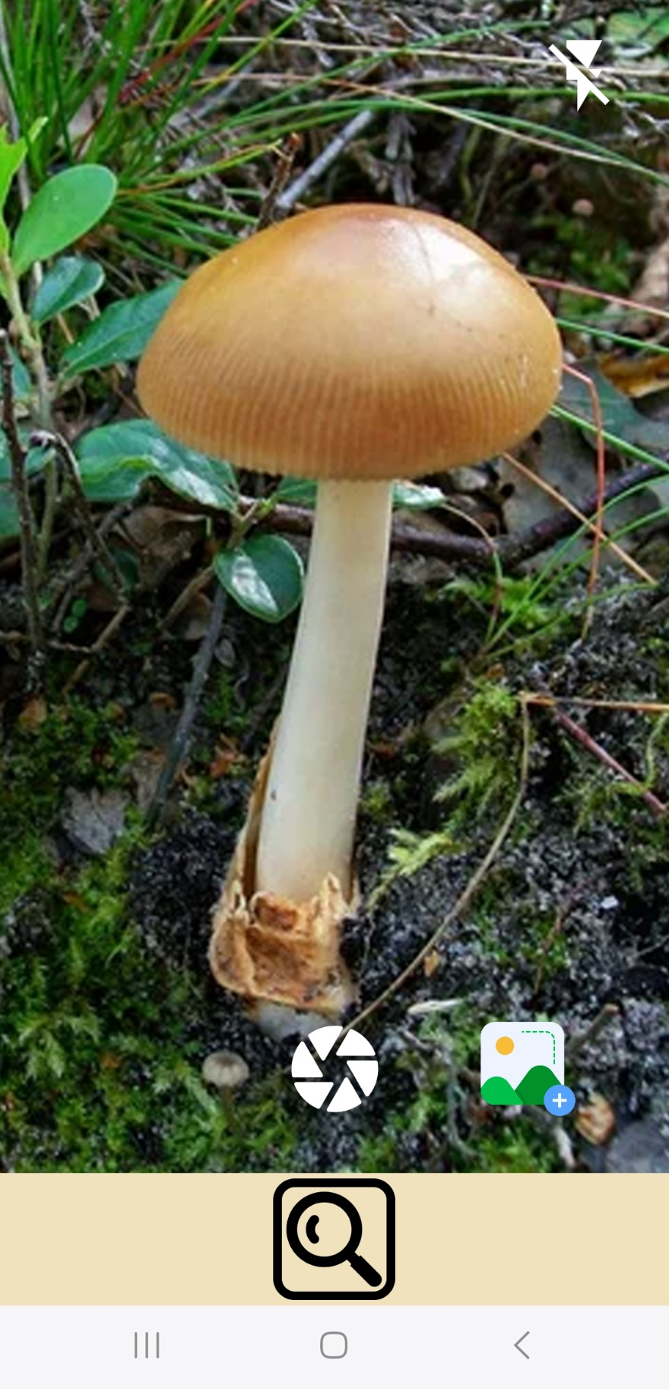
mushroom identification app

Slide 3

What’s its purpose?
mushify is an advanced identification app that quickly analyzes photos of mushrooms—taken via camera or uploaded from your gallery. it identifies the species,
provides edibility and toxicity information, and shows a probability score for accuracy.

Slide 4
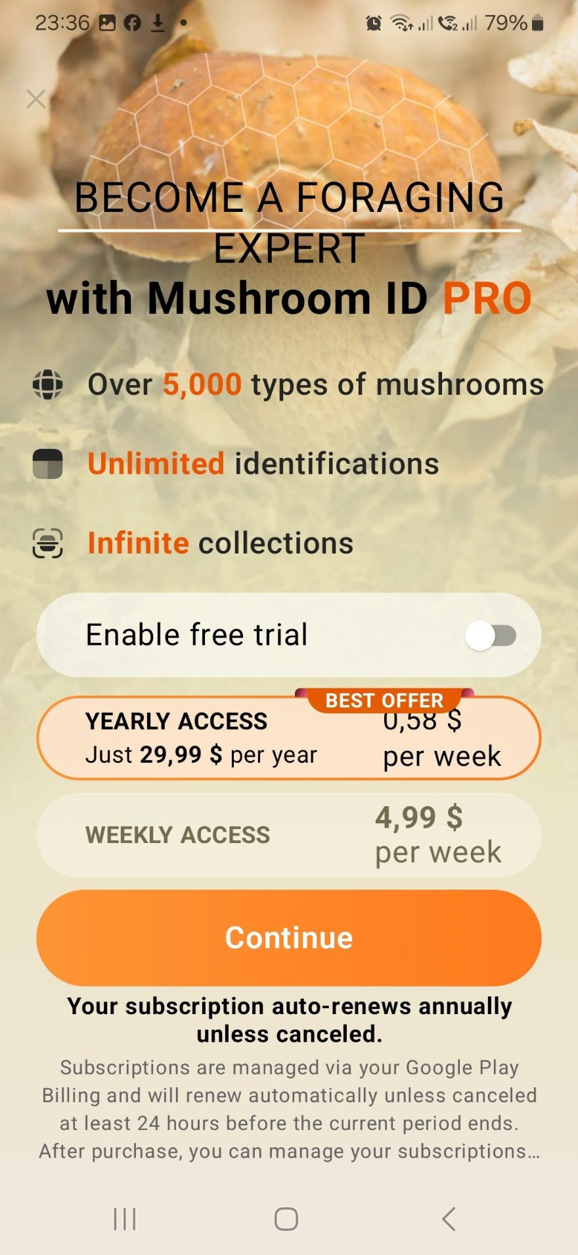


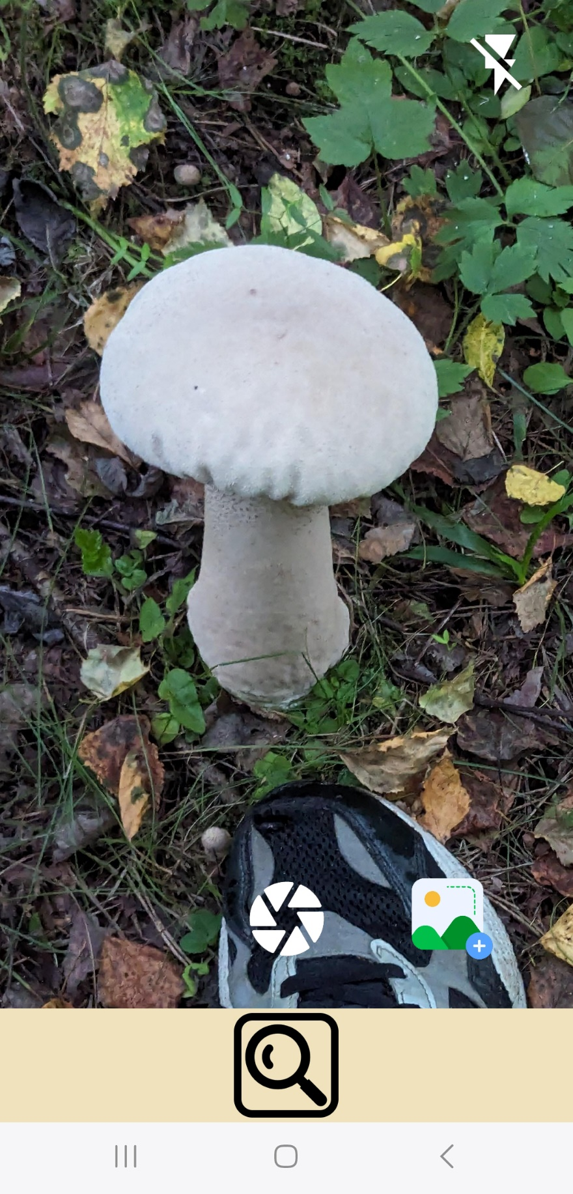

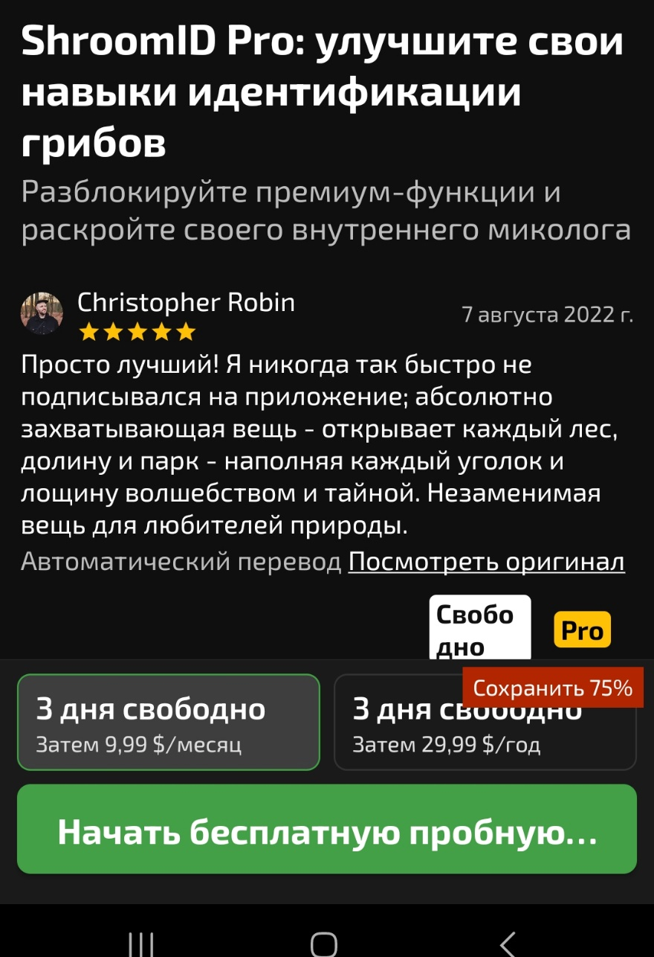
Is it free?
Unlike some of our competitors, mushify is completely free to use

Slide 5
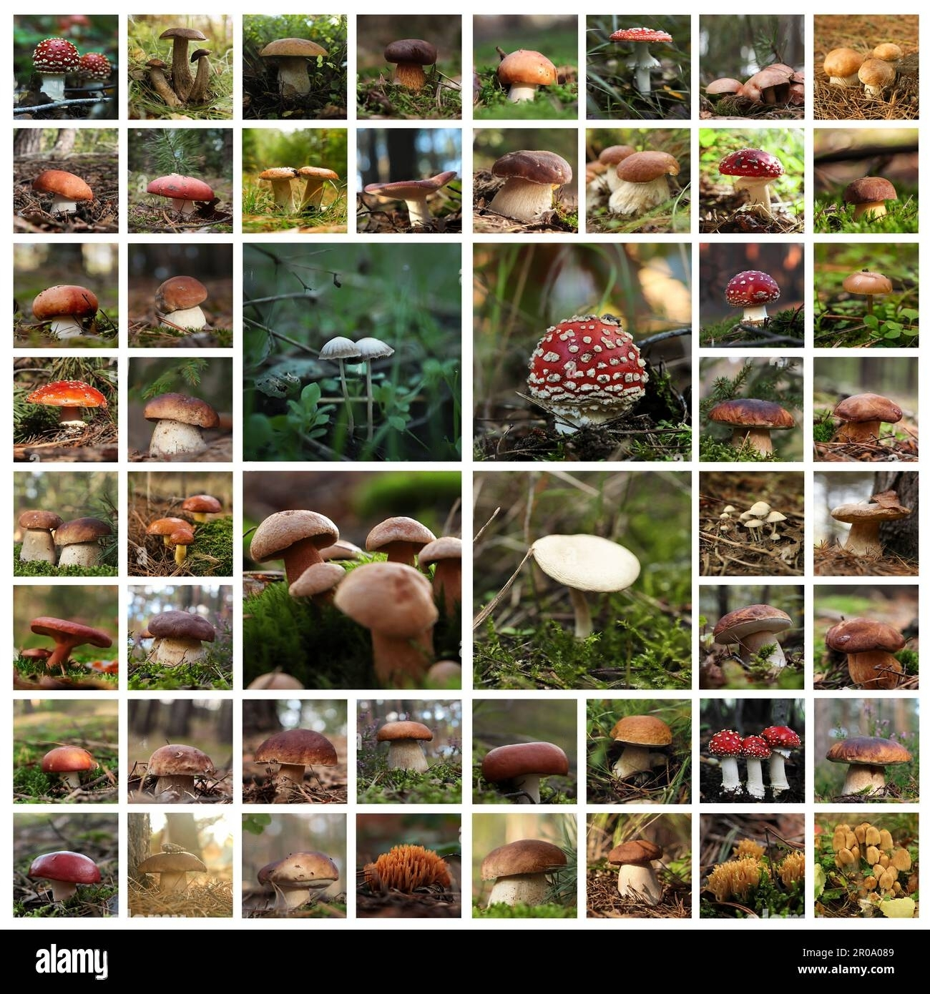
Why is it important?
Every year, there are between 5,000 and 10,000 cases of mushroom poisoning worldwide. Several hundred of these are fatal.

Slide 6

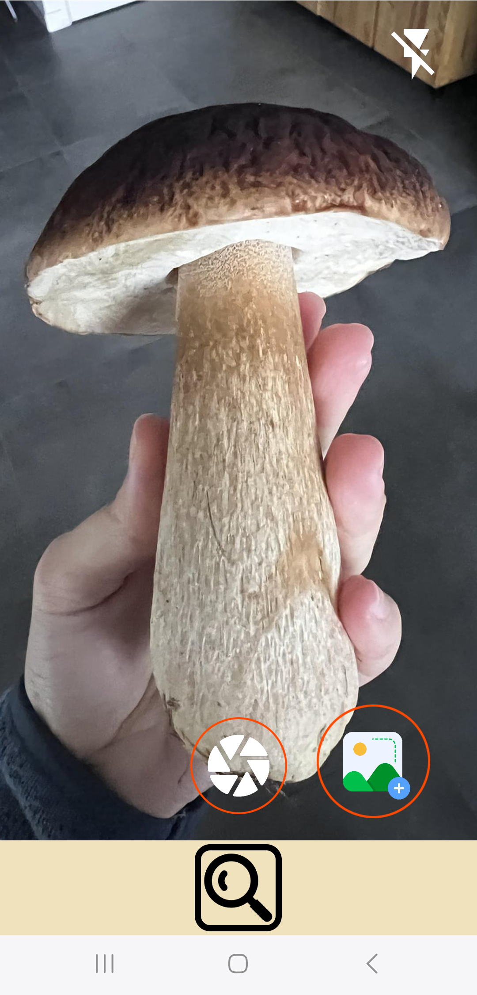
You can either take a photo using your phone's camera or upload one from your gallery
Select from gallery
Take a photo

Slide 7
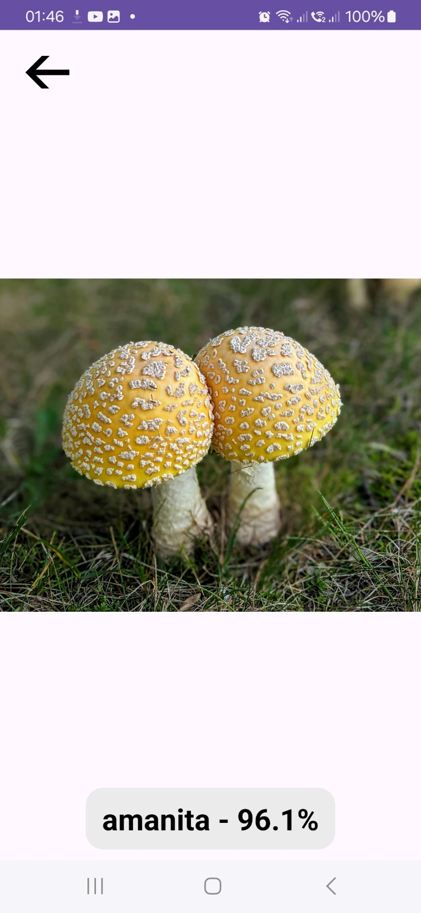
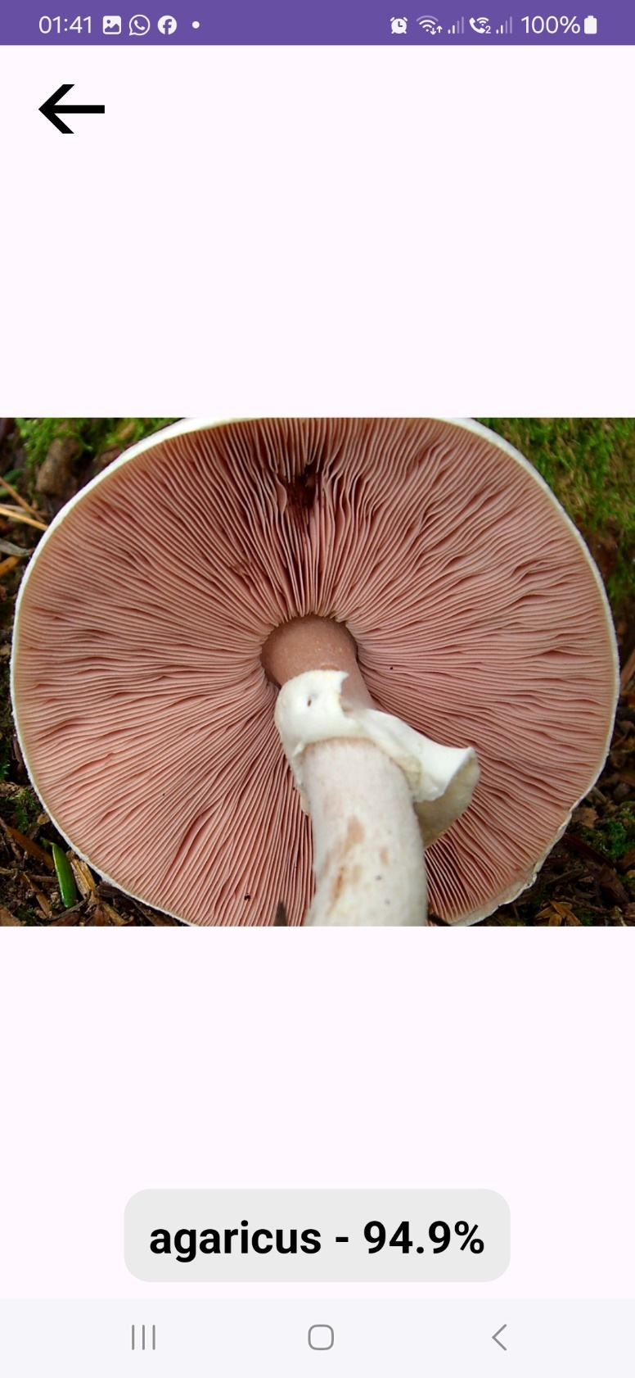
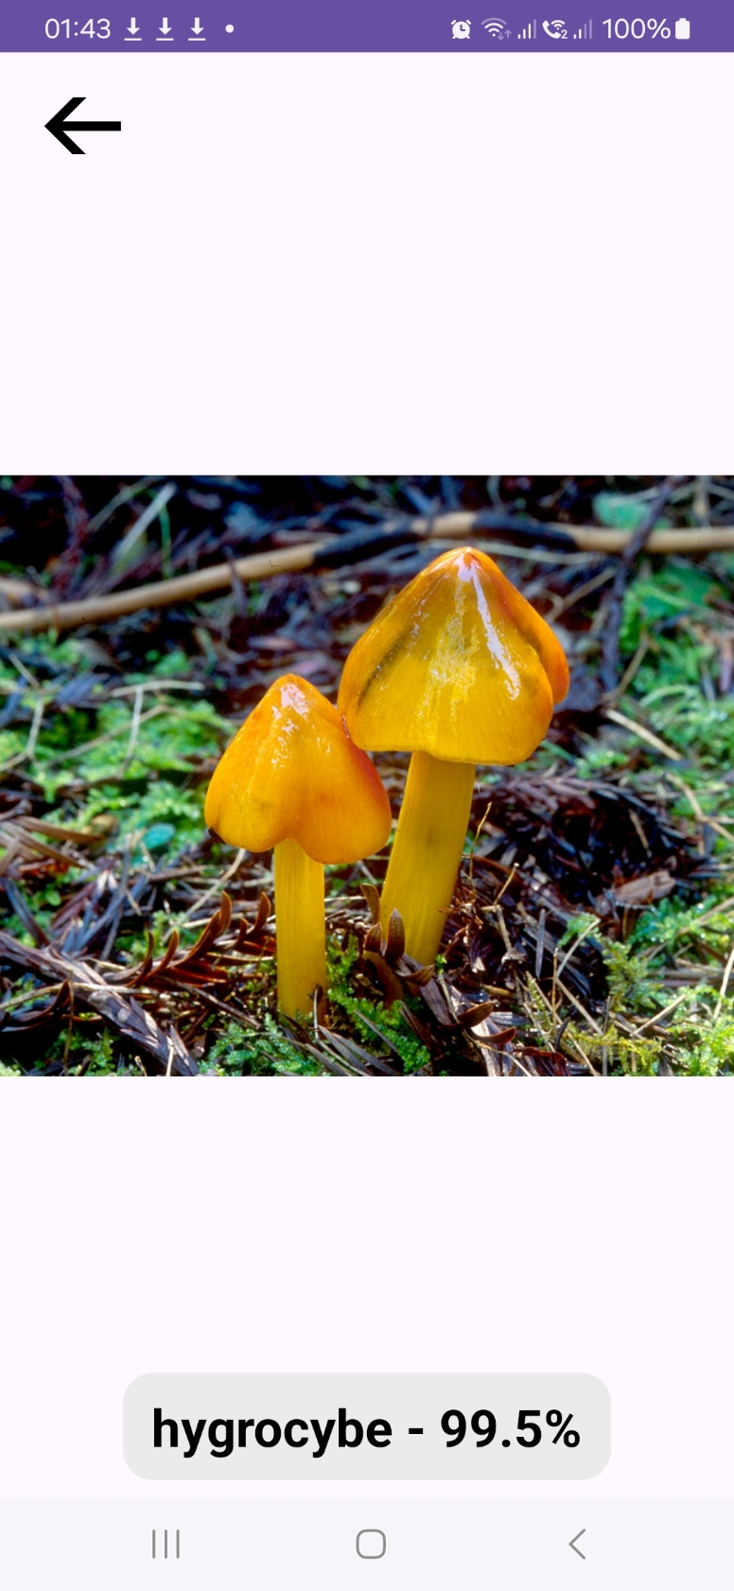
Recognizes mushrooms with high accuracy

Slide 8





Today
Future
Mushify recognizes some types of mushrooms (you can see the full list on the website)
Mushify will recognize most existing mushroom species with high accuracy, providing information on whether they are edadable

Slide 9
Why is our app the best?
App | Fully Free | Only 1 image to identify | Fast | Easy interface | Offline
Mushify | + | + | + | + | +
Picture Mushroom | - | - | + | - | -
Mushroom identificator | + | - | - | - | -
Mushroom ID | - | + | + | + | -

Slide 10


THE END
Mushify

